Slide 1
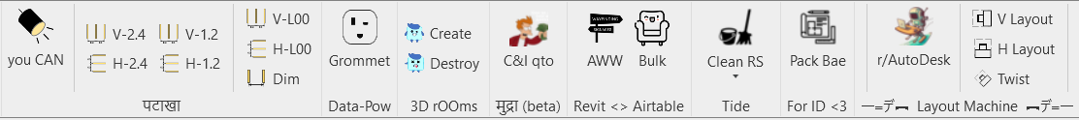
Revit Automation Tools
Design Automation
Lighting layout.
Power and Data grommet layout.
Automated Wayfinding Workflow
Layout Automation
Package B Automation in Revit
BIM Model QC
Clean Room Separation Lines
Ghosted Desk Workset
Quantification
C&I Quantity takeoff.
Quantification automation at concept stage
Bulk furniture cost export

Slide 2
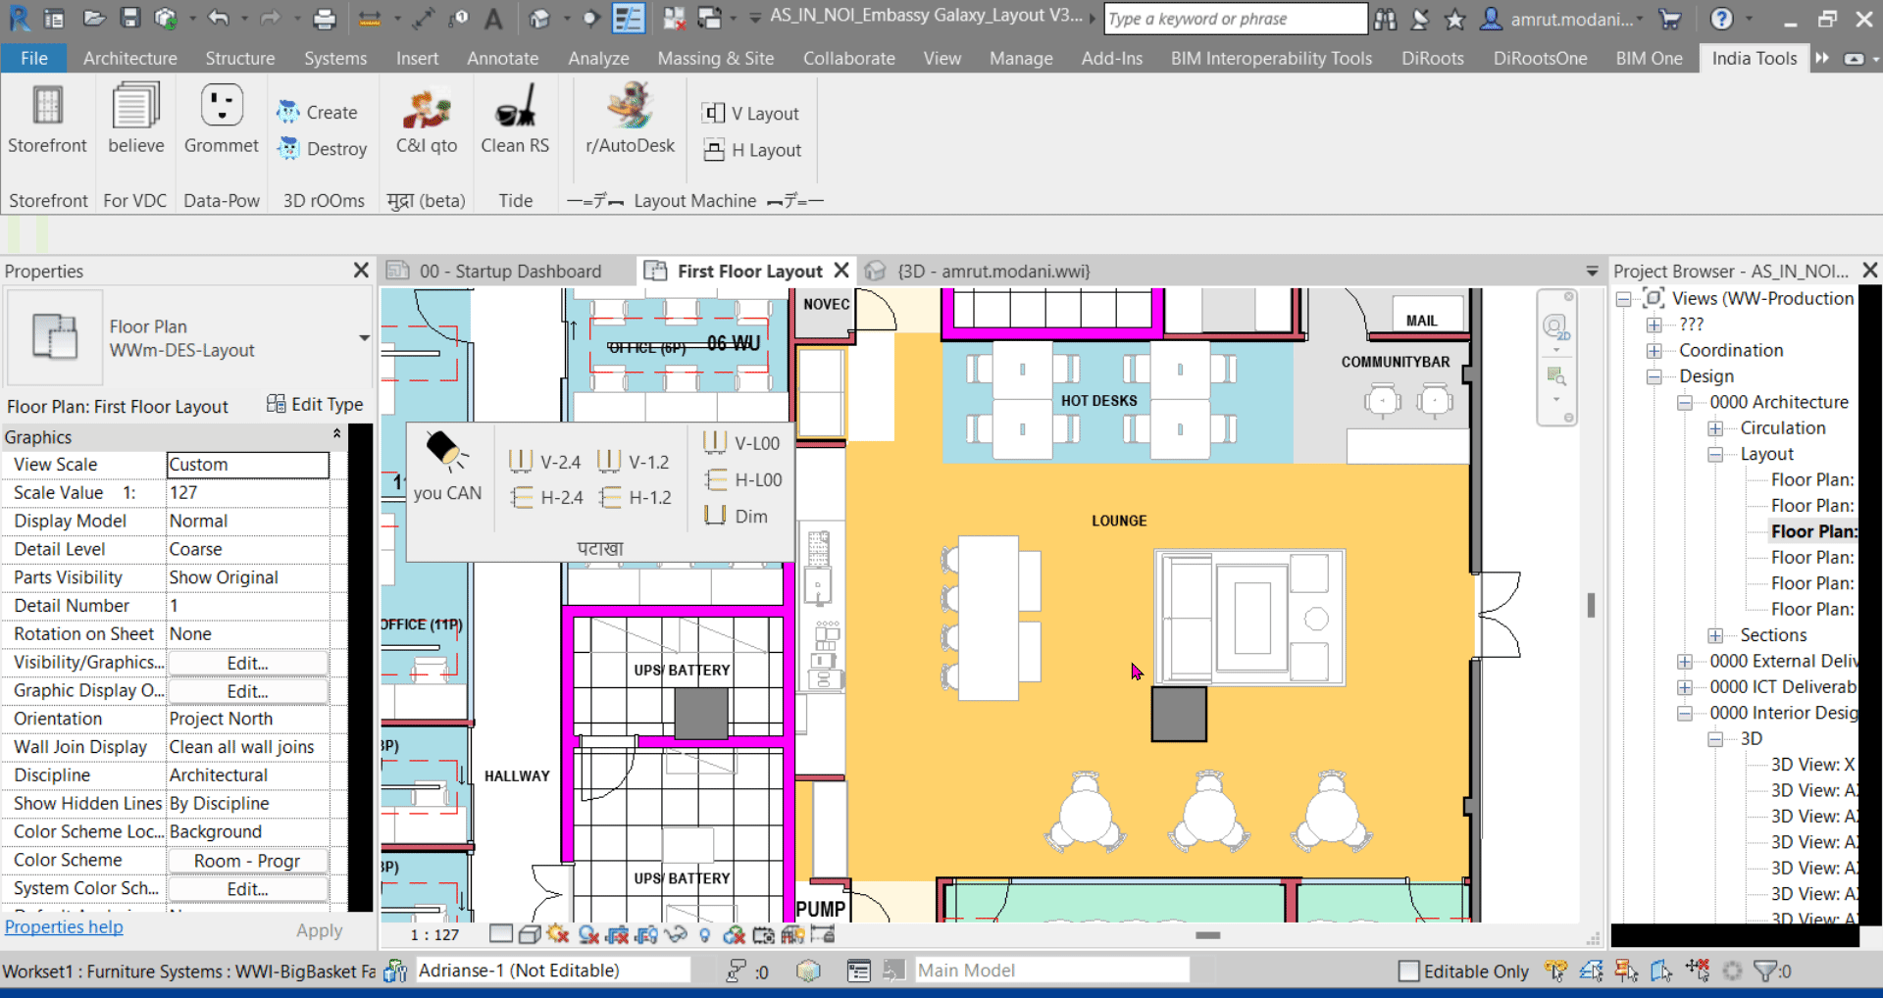
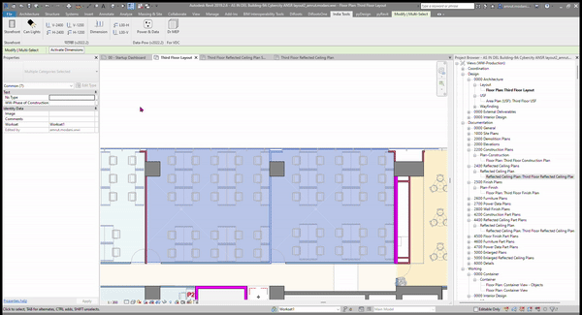
Lighting layout automation
Automation for Lighting Layout. Can Lights for We, Circulate spaces
Linear Lights for work spaces.

Slide 3
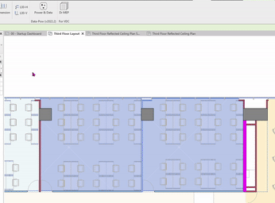
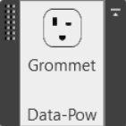
Grommet layout automation
Automation for grommets placement as per desk layout in offices. (1:1 ratio for power and data)

Slide 4
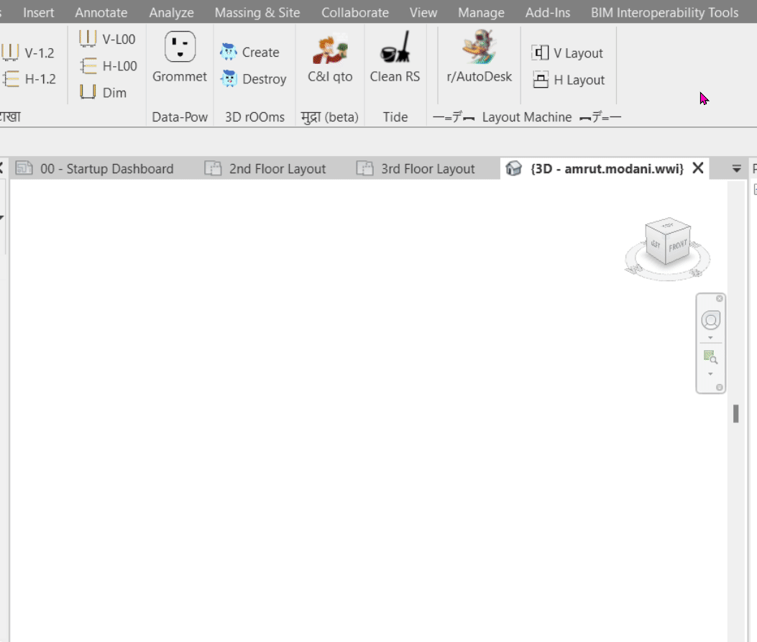
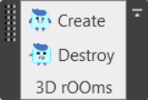
3D Rooms
Automation to create 3D rooms for programming presentation

Slide 5
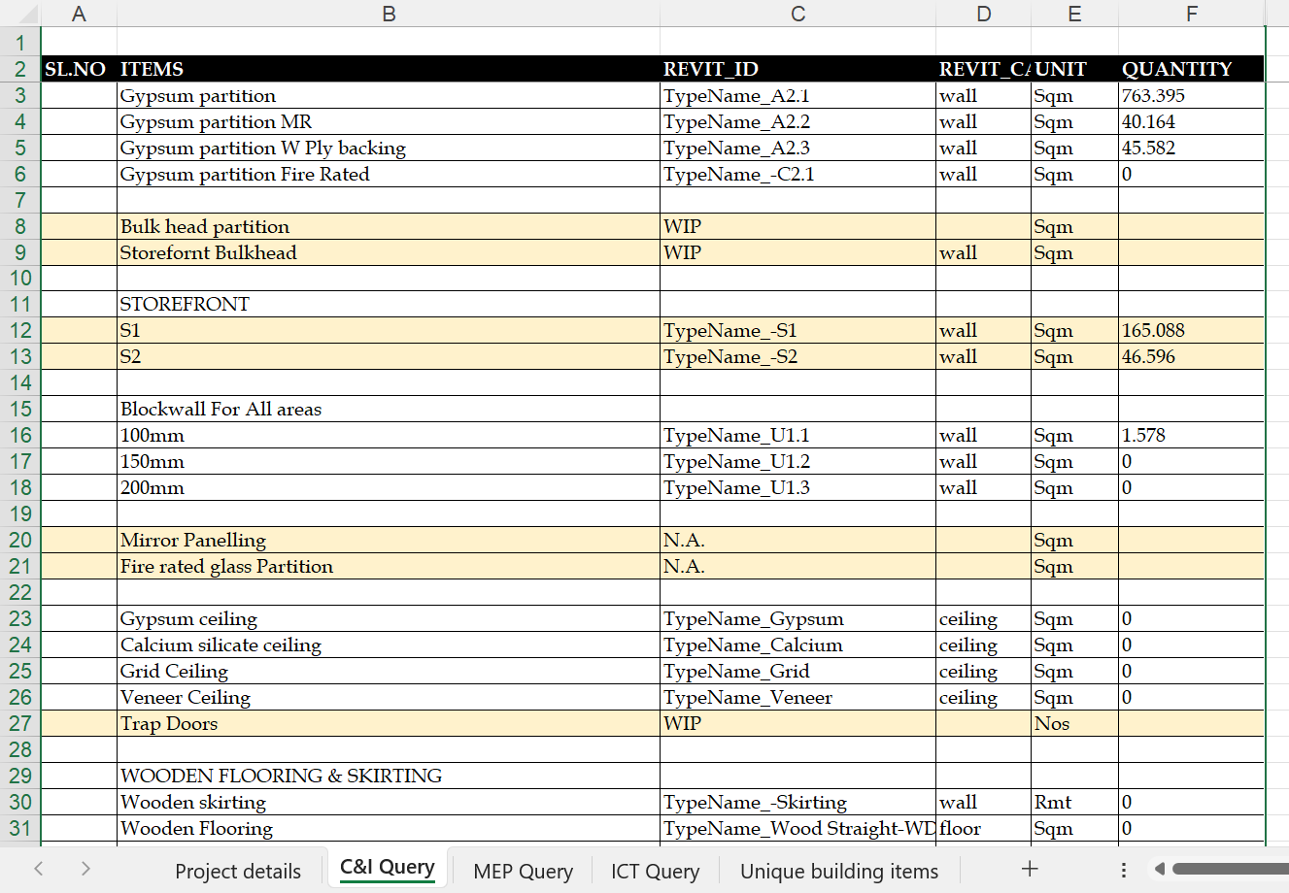
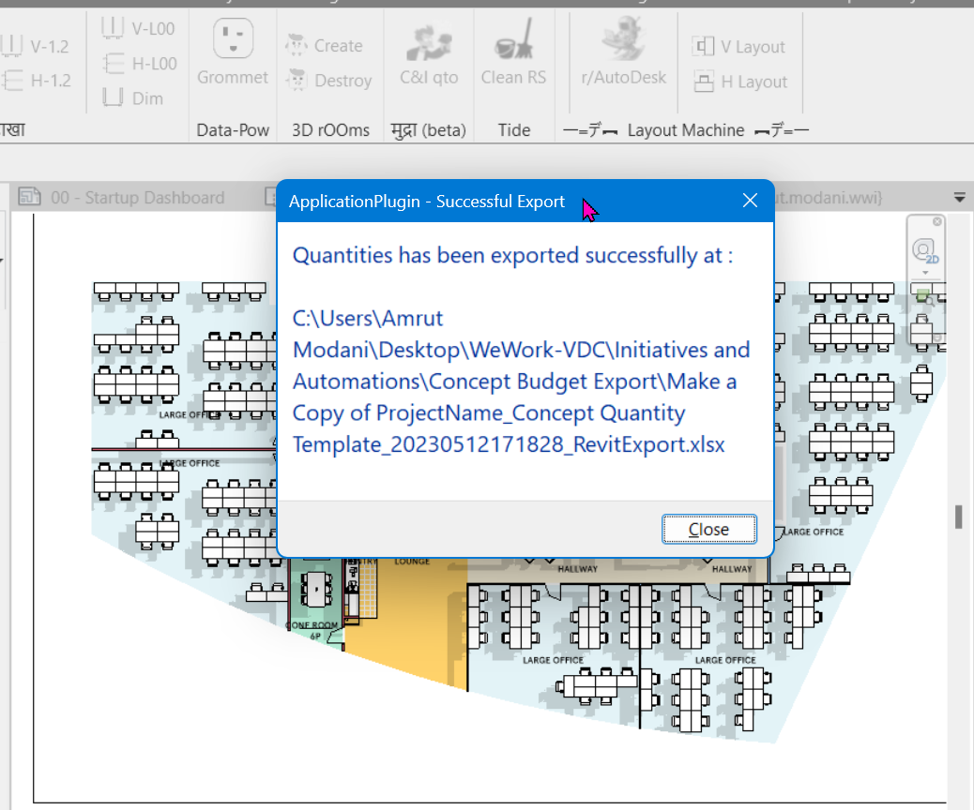

C&I qto Automation
Automation for C&I quantities extraction after package A

Slide 6
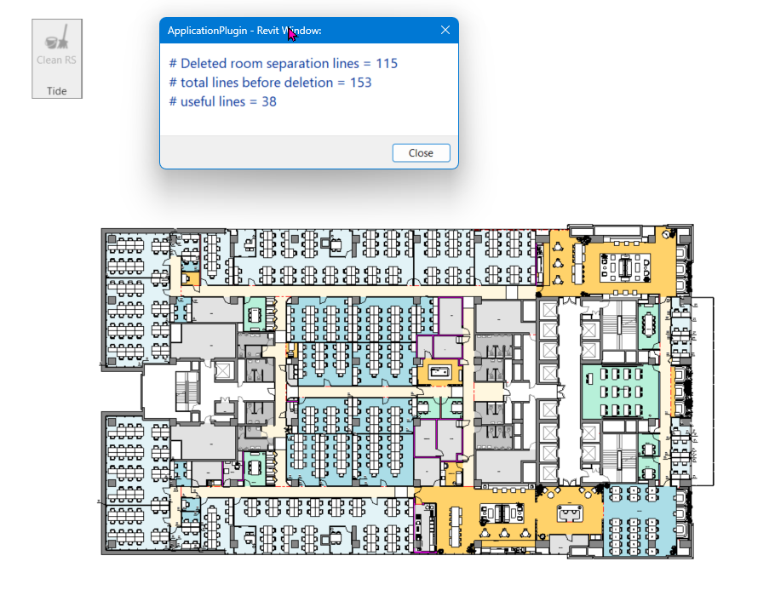
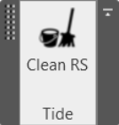
Room separation cleanup
This tool helps Studio team in keeping the quality of design models and remove any unnecessary room separation lines from 3D model.
This results in better quality of as built as well as 3D Revit models become light to handle.

Slide 7
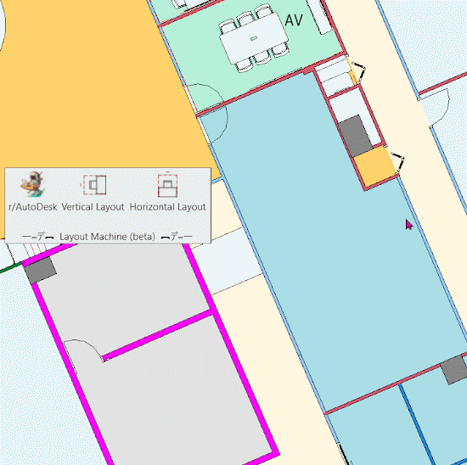
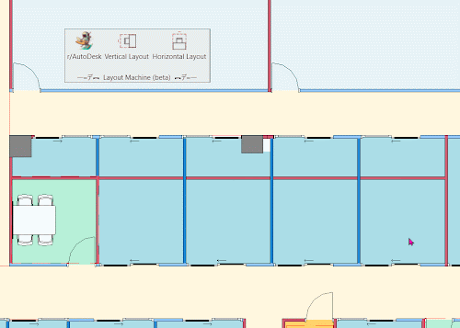
Desk layout automation
This tool helps the Studio team in generating desk layouts in office spaces fairly quickly.
This tool helps in L3 Testfits, classic Layouts and custom projects.

Slide 8
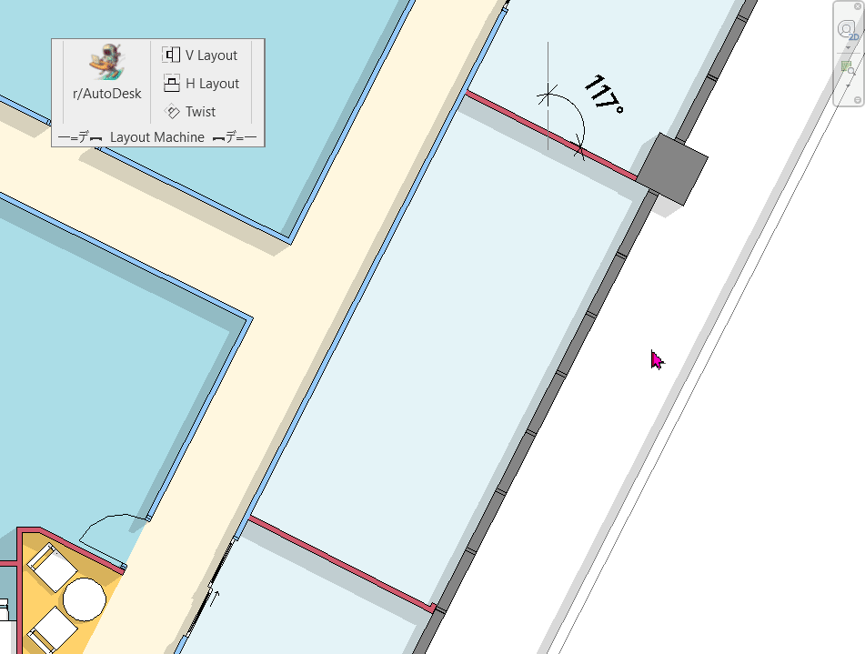
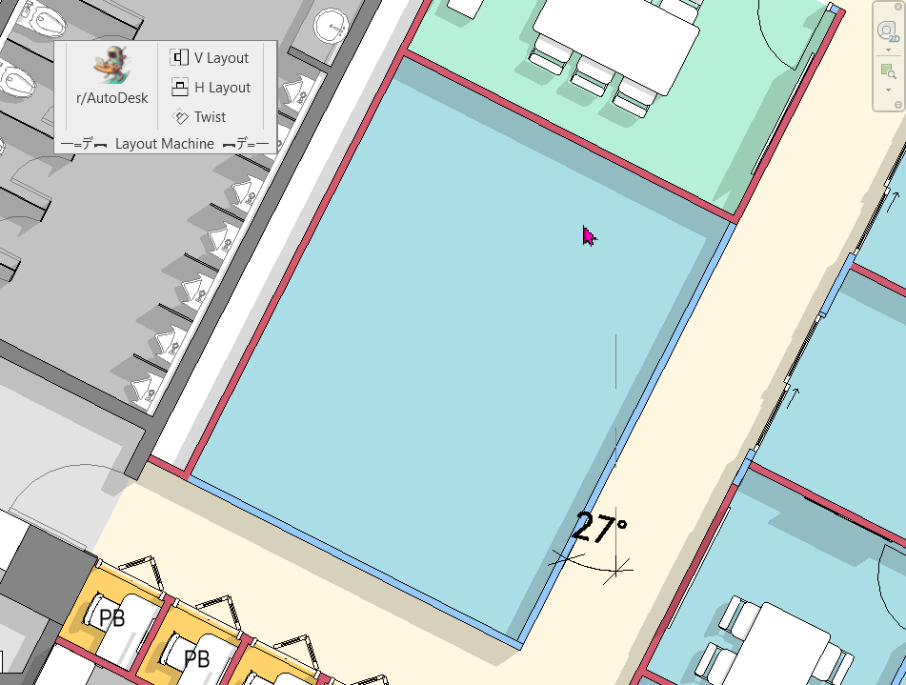
Desk layout automation
Feature Update : Added the new tool button to incorporate rotated Rooms

Slide 9
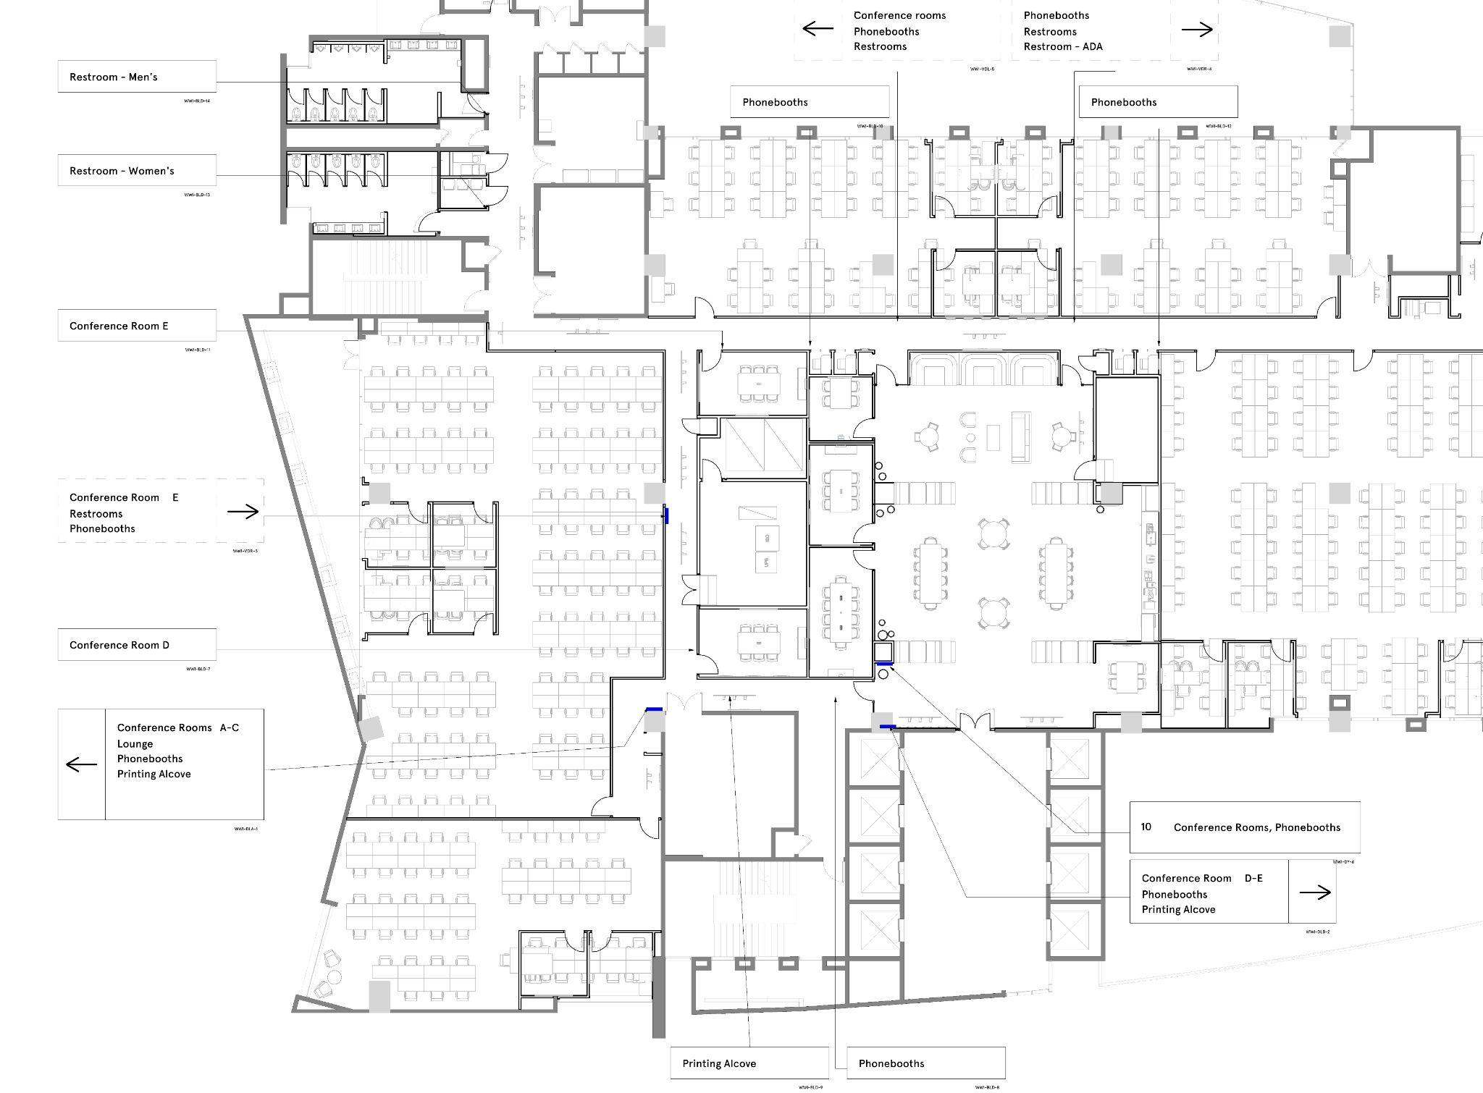
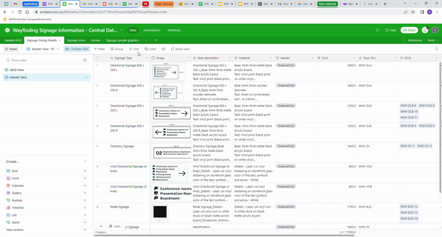
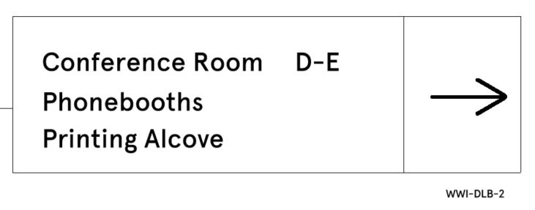
Automated Wayfinding Workflow
Innovative way to create wayfinding plan in Revit and export to standard’s wayfinding Airtable to generate BOQ and Production drawings.

Slide 10
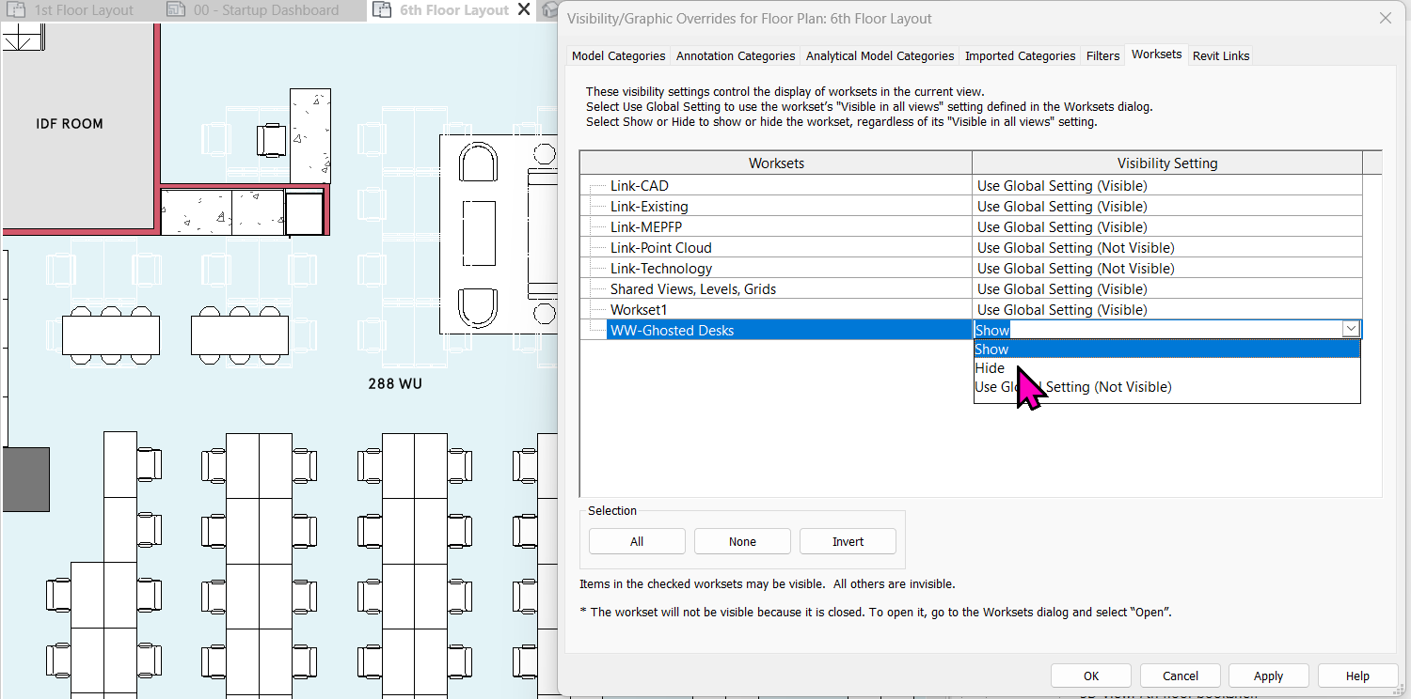
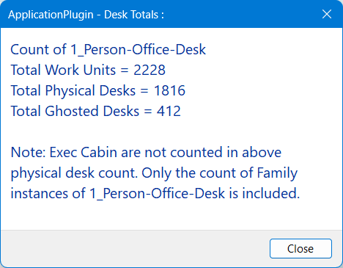
Ghosted Desk workset correction
Changes ghosted desks' workset for better quality control of Revit models and easier visibility controls for ghosted desks. (Helps in quality control of Revit models)

Slide 11
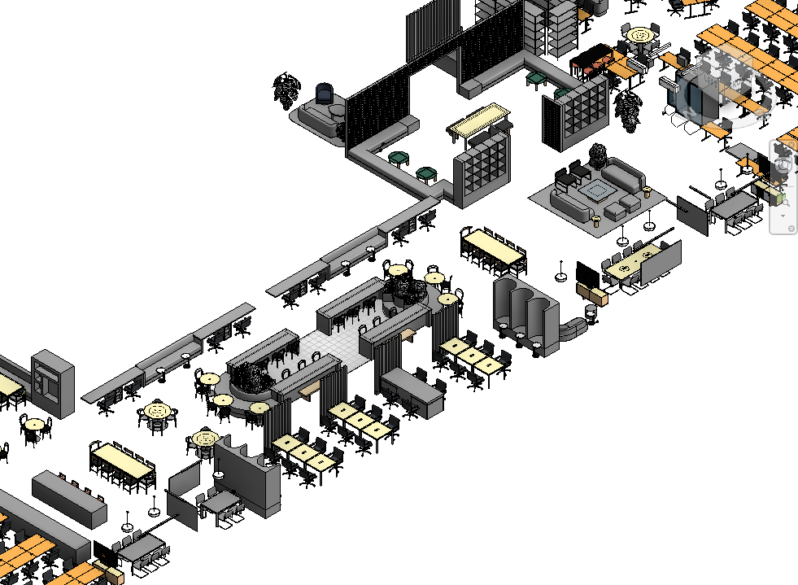
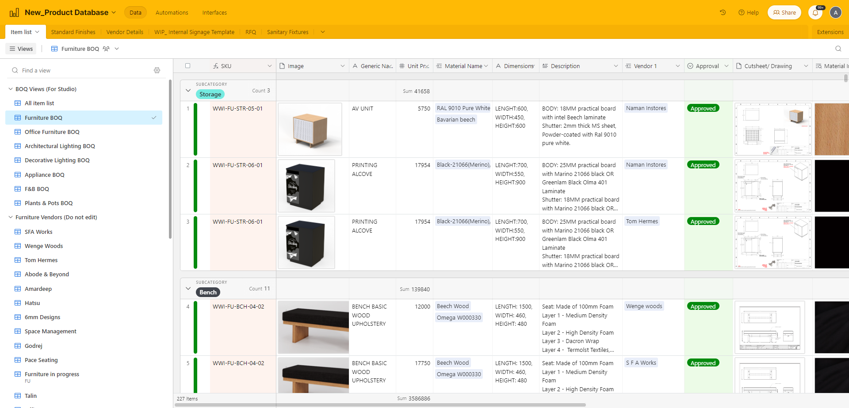

Bulk Furniture cost export
This tool exports the bulk items in an excel for a quick cost check on the design based on New Product Database. (Helps in monitoring the project cost of bulk approved items)

Slide 12
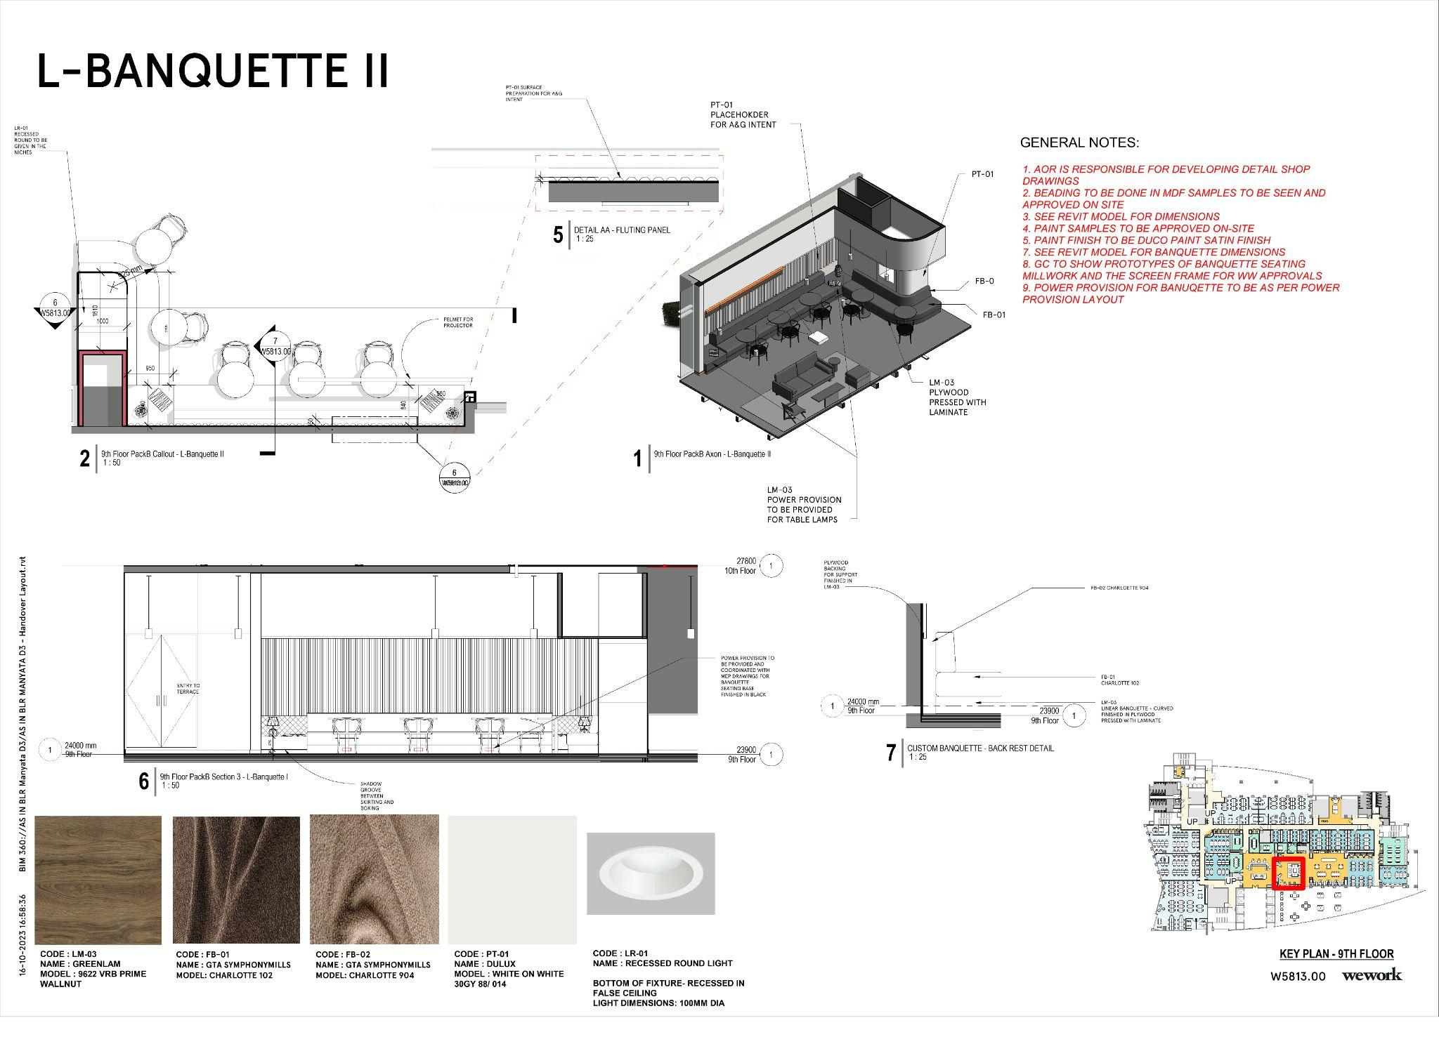
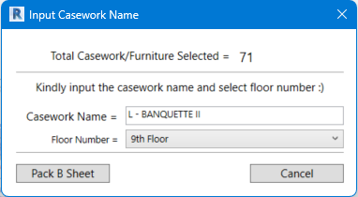
Package B Automation
This tool automated, standardized and streamlined the Package B creation in Revit.
Reduces working hours and improves on the overall sheet quality of the package B and makes it more consistent across projects.

